Slide 1




Welcome to
Blackpool School of Computing
Your Journey Starts HERE!
22 September, 2025

Slide 2


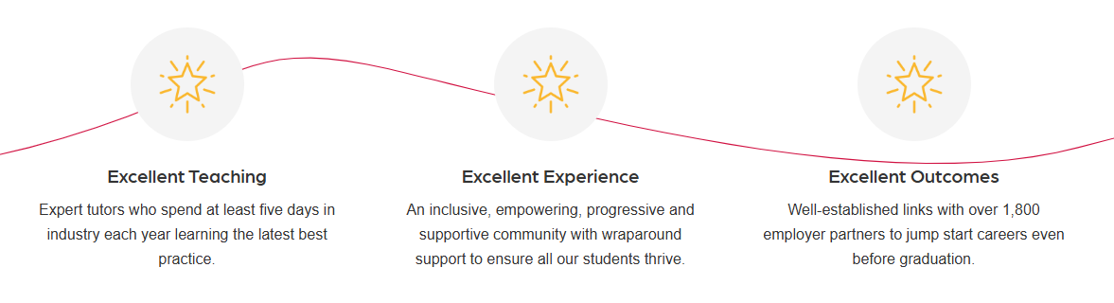

Welcome to Blackpool & The Fylde College
Your Future is in safe hands
At B&FC, we’re proud to hold TEF Gold, one of only two providers in the Northwest to achieve Gold in all three categories: Overall, Experience and Outcomes
Well-established links with over 1,800 employer partners, including major industry leaders like Vodafone, to jump-start careers even before graduation.

Slide 3
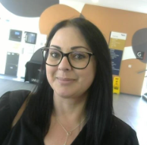

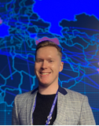

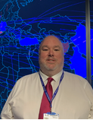

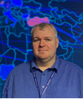
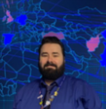
Our Team
Dr Colette Mazzola-Randles
James Dunkerley
Anthony Parkinson
Clare Ruckledge
Operations Manager
Apprenticeships
Programme Leader
Higher Degree Apprenticeships
Programme Leader
Apprenticeship Progress
Trainer
Apprenticeship Progress
David Lawless
Maria Anthony
Jason Walker
Kyle Cameron
Lecturer
Cyber Security Specialist
Lecturer
Data Analyst Specialist
Lecturer
Software Engineer Specialist
Lecturer
Network Engineer Specialist

Slide 4
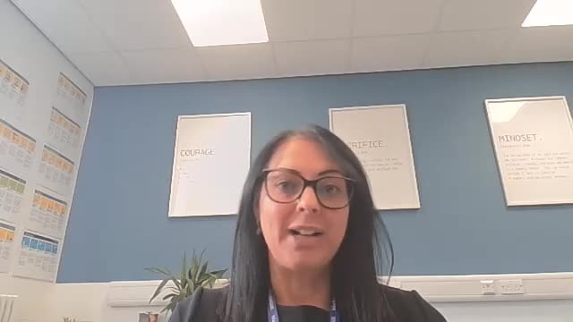
Welcome From Colette

Slide 5



Level 3
Cyber Pathway -David Lawless
&
Software pathway -Jason walker

Slide 6
🗓️ YOUR LEVEL 3
LEARNING DAY(Monday)
DAY
📅 Microsoft Teams Online call schedule | 📅 Full-Day Structure (Online via Microsoft Teams) | 📅 Full-Day Structure (Online via Microsoft Teams)
Time | Session | Description
09:00 – 10:00 | Progress Tutorial | Group tutorials for OneFile, Progress, PRMs, support, and catch-up
10:00 – 13:00 | Module One | Tutor-led delivery, Q&A, and Independent study
13:00 – 14:00 | Lunch | Time away from screen – please use this break
🧭 You’ll receive Teams invites for all sessions via your calendar.

Slide 7

English and Math's
Apprentices without level 2 English and maths will need to achieve this level prior to taking the End-Point Assessment.
For those with an education, health and care plan or a legacy statement, the apprenticeship’s English and maths minimum requirement is Entry Level 3.
A British Sign Language (BSL) qualification is an alternative to the English qualification for those whose primary language is BSL.

Slide 8
Scheme of Work - Cyber Pathway
Module 1: Cyber Security Foundations and Compliance
Module 2: Cyber Security Operations and Helpdesk
Module 3: Security Policy and Risk Management
Module 4: Technical Security Controls and Asset Management
Module 5: Advanced Security Monitoring and Threat Management
Module 6: Professional Development and Continuous Learning

Slide 9


Module1:
Cyber Security Foundations and Compliance
(3 months)
Module 2:Cyber Security Operations and Helpdesk
(3 months)
Module 3: Security Policy and Risk Management (2 months)
Module 5: Advanced Security Monitoring and Threat Management (2 months)
Module 6: Professional Development and Continuous Learning
(1 month)
Module 4:
Technical Security Controls and Asset Management Practices
(3months)
Portfolio Development Collation and mock EPA (8 Pieces of evidence)
(3 Months)
Gateway (15 months)
Assessment method 1: Scenario Demonstrations with questioning
Assessment method 2: Professional Discussion underpinned by Portfolio
Assessment method 3: Knowledge Test

Slide 10
Scheme of Work - Software pathway
Module 1: Introduction to Software Development and Stakeholder Engagement
Module 2: Algorithms and Programming Fundamentals
Module 3: Documentation and Project Management
Module 4: Secure Development Practices
Module 5: Software Testing and Quality Assurance
Module 6: Professional Development and Continuous Learning

Slide 11
Module1:
Introduction to Software Development and Stakeholder Engagement
Module 2:Algorithms and Programming Fundamentals
Module 3: Documentation and Project Management
Module 5: Software Testing and Quality Assurance
Module 6: Professional Development and Continuous Learning
Module 4:
Secure Development Practices
Portfolio Development Collation and mock EPA (8 Pieces of evidence)
(3 Months)
Gateway (15 months)
Assessment method 1: Scenario Demonstrations with questioning
Assessment method 2: Professional Discussion underpinned by Portfolio

Slide 12
OneFile & Progress Meetings
OneFile is an e-portfolio platform utilised to document your off-the-job hours in the Learning Journal, complete Scorecards, attend Progress Review Meetings, and a place for tutors/faculty staff to add notes.​
We can update your progress on OneFile by signing off modules and assessments you have completed; this provides a clear picture to Blackpool & The Fylde College and your employer regarding your progress.​
Progress Review Meetings are conducted every 8 weeks. They consist of a 30-minute chat with a Skills Coach regarding your progress. It allows your employer and the training provider to touch base on your development at university and in the workplace. It fulfils the tripartite agreement between the three parties.​

Slide 13
Learning Journal
The Learning Journal is utilised to document your OTJ hours.​
​
It must be completed at the end of each OTJ day. For example, if your university day is a Tuesday, you would complete a Learning Journal at the end of that day.​
​
Learning Journals must be completed at least every 20 days or else you put yourself and the university in breach of the funding rules.​
​
Learning Journals must be reflective. A sentence stating you attended university will not be accepted. A third party should be able to read your Learning Journals and understand what you learnt during your OTJ hours.​

Slide 14




Developing your character….
During your Progress Review Meetings, we will discuss a range of hot topics, guide on enrichment opportunities, and ensure we can keep you safe through discussions, activities and B&FC events.
Your PPD curriculum is your opportunity to further develop your own unique character during your time here with us at B&FC.
Here are the British Value Stamp Logos to watch out for at B&FC...

Slide 15
Off The Job Training
Off-the-job (OTJ) hours is defined as learning which is undertaken outside of day-to-day work duties and leads towards the achievement of your apprenticeship. This training takes place with your normal (contracted) working hours.​
​
The OTJ training must be directly relevant to the apprenticeship and the minimum number of hours is 6 hours per week. OTJ hours allow for the development of the required knowledge, skills, and behaviours (KSBs).​
​
Knowledge - the information, technical detail someone needs to have and understand. Some knowledge will be occupation-specific, whereas some may be more generic.​
​
Skills - the practical application of knowledge needed to successfully do their duties. They are learnt through on- and/or off-the-job training or experience.​
​
Behaviours - mindsets, attitudes or approaches needed. Whilst these can be innate or instinctive, they can also be learnt. Behaviours tend to be very transferable. They may be more similar across apprenticeships than knowledge and skills. For example, team worker, adaptable and professional.​
​
A List of OTJ Activities​
  Completing course assignments​
  In-house training​
  Working through a relevant course or qualification​
  Shadowing​

Slide 16
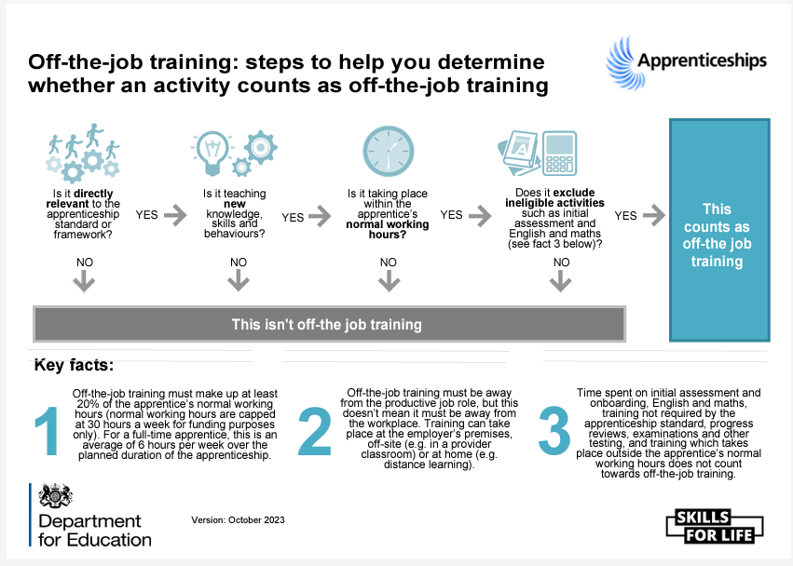
Off The-job Training

Slide 17
Activity | Description
Working through a relevant course or qualification | Completing online learning modules or attending classes, conducting research, and seeking advice from a tutor or teacher
Completing course assignments | Working on assignments, including practice/formative assessments
Guided mentor/coach visits | Sessions with a mentor/coach in which learning is taking place
In-house training | Training provided by your organisation to develop skills that are related to the apprenticeship
Shadowing | Being assigned to shadow a colleague to observe them perform their job role
Mentoring | Using skills/knowledge to provide colleagues with developmental advice
Workshops/masterclasses | Meetings where training and/or discussions have taken place around topics or skills related to the apprenticeship
Industry visits | Visits to external organisations or departments within your organisation

Slide 18
Learning support | Support provided by your organisation related to professional development
Completing workbooks/tasks | Completing written material which is linked directly to the apprenticeship
Preparation for professional discussion | Any time spent preparing information or materials prior to a professional discussion
Gathering evidence for e-portfolio | Gathering content for the e-portfolio
Gathering evidence for reflective discussion | Preparing information or materials prior to a reflective discussion
Attendance at conferences | Attending conferences relevant to the apprentice’s job role, professional development, or apprenticeship
Simulation/role play exercises | Carrying out a controlled activity to practise for a real-life situation
Additional support/accommodations | Revision classes, personal support, additional time or other accommodations for apprentices with additional learning needs
Networking events | Attending networking events related to professional development within the apprenticeship

Slide 19
Numeracy and or literacy training required to perform the job | English and maths related to the job
Peer-to peer-support | Discussions/joint working with colleagues
Research | Background working to improve knowledge; research tasks to gain new knowledge
Revision for exams and end-point assessment | Preparation for ongoing end-point assessment
Workplace one-to-one performance reviews | Staff review and development meetings; development meetings with line manager.

Slide 20

Finally, it’s worth noting that off-the-job training does not include:
English and maths (up to Level 2) that is funded separately
progress reviews or on-programme assessment needed for an apprenticeship standard
Training that takes place outside the apprentice’s paid working hours.

Slide 21
End Point Assessment
Completed by the BCS
British Computer Society

Slide 22
Support

Slide 23
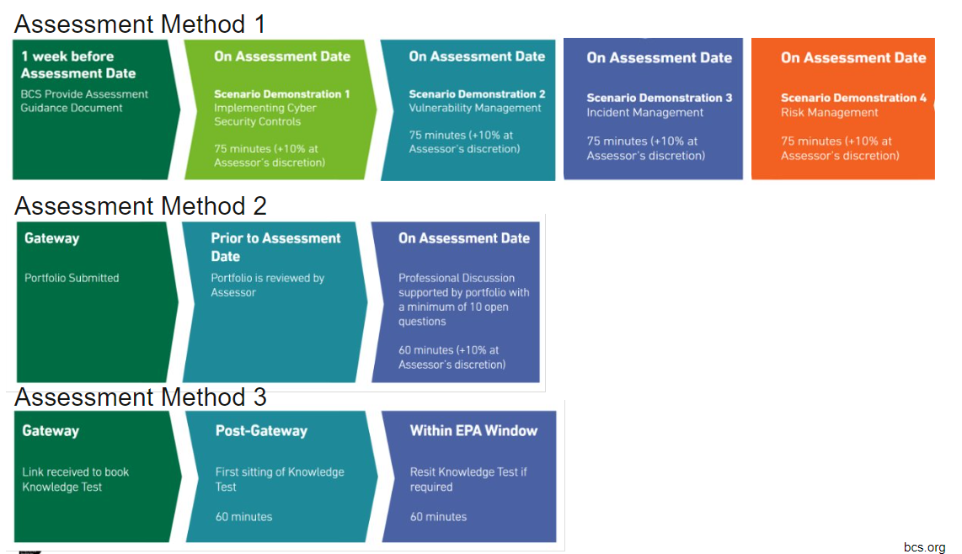
Cyber Pathway

Slide 24
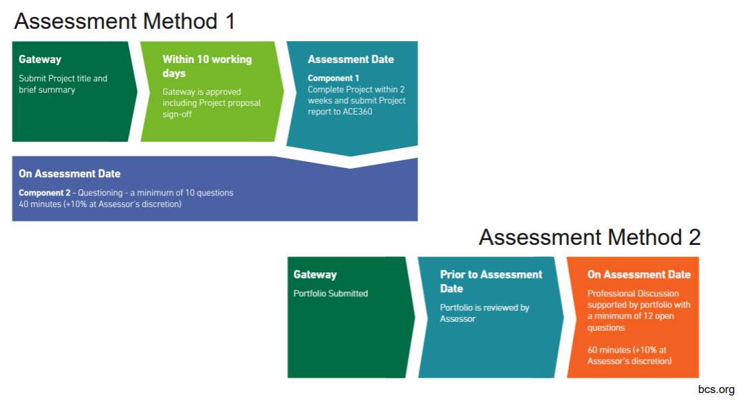
Software Pathway

Slide 25



Pre Course - Assessment Task
Cyber Pathway
Software pathway

Slide 26



VLE (Virtual Learning Environment) Tools

Slide 27
Academic best practice
Research and Referencing (Citations and Intext Citations)
Journals and Books (e.g., Google Scholar, EduSearch, IEEE Explore)
Artificial Intelligence (AI) Tools (e.g., CoPilot / ChatGPT / Gemini)
Time management (e.g., Outlook Calendar, Trello, ToDo List)
Task management (as above)

Slide 28

Plagiarism
Plagiarism is the process of creating works based on existing work without assigning credit.
There are multiple forms of Plagiarism, and you need to be aware of what is considered to be plagiarism.

Slide 29
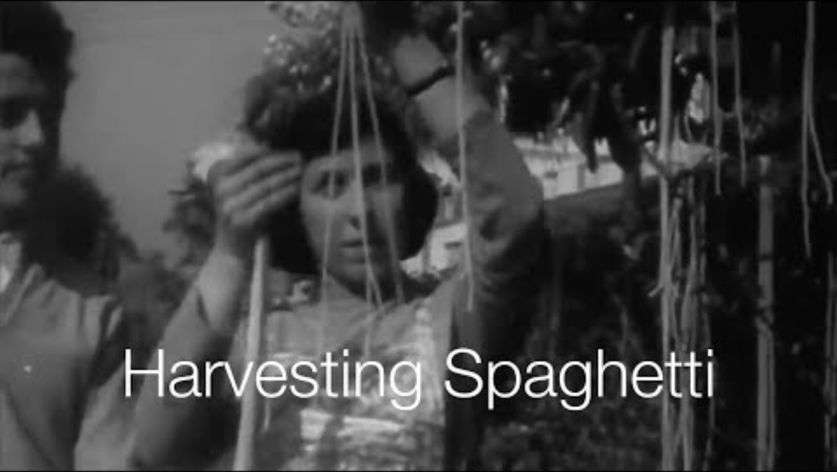

Slide 30

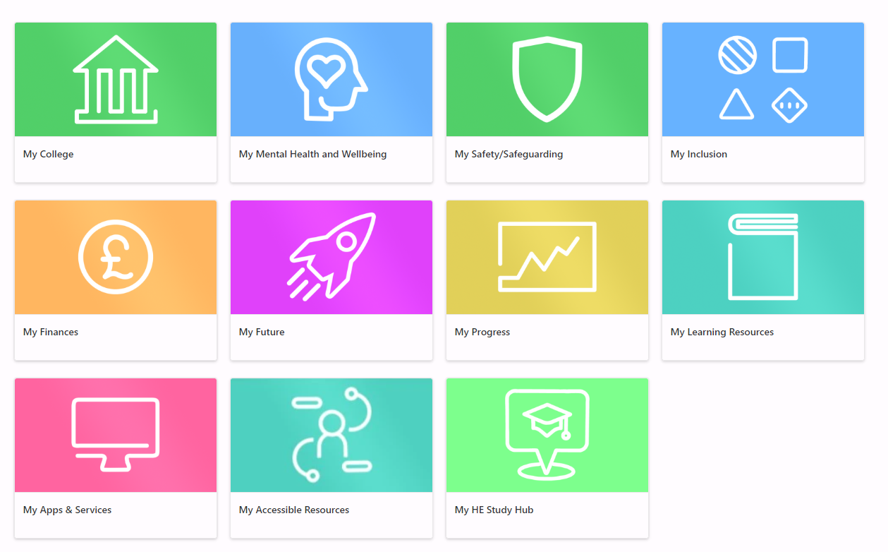


Slide 31
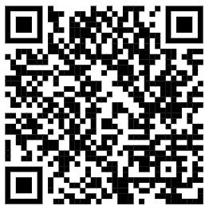
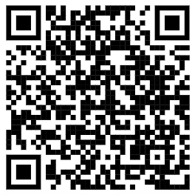
Additional Resources
How to create a PowerPoint Presentation
https://www.youtube.com/watch?v=gkNGtBlZOwo
Using Office365
https://www.youtube.com/watch?v=psHKqAJ03HQ

Slide 32
Any Questions?

Slide 33


Thank you
Get Proactive
Software Development
- https://www.linkedin.com/learning/software-development-life-cycle-sdlc
Cyber Security
- https://www.linkedin.com/learning/cybersecurity-foundations-governance-risk-and-compliance-grc/

